Slide 1
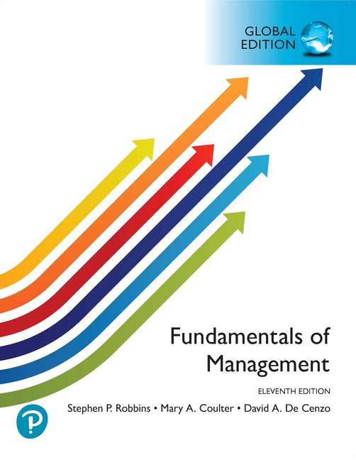
現代管理學 ch1 管理者與管理
1-<number>

Slide 2
0
Evolution of Management Thought
Evolution of Management Thought

Slide 3
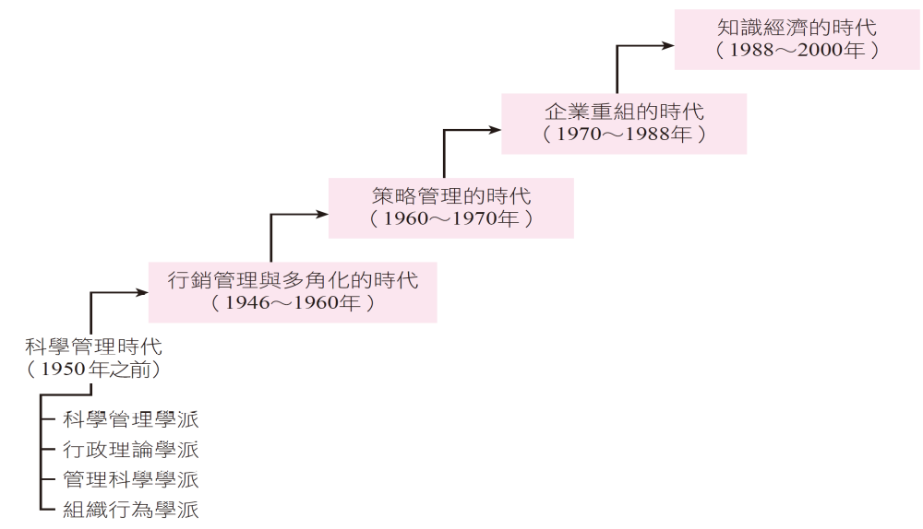
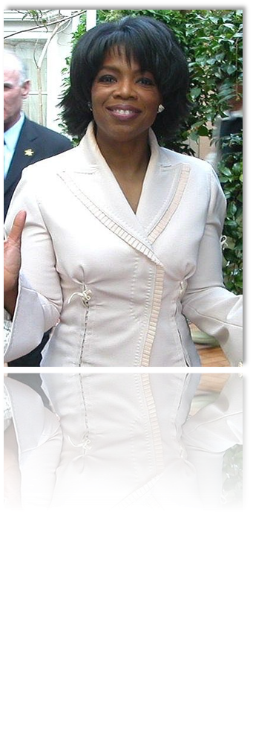
Evolution of Management Thought
1-<number>

Slide 4


1. Early
Adam Smith (亞當‧史密斯) proposed the Wealth of Nations in 1776, advocating division of labor and comparative advantage as pathways to wealth creation
Impact of the Industrial Revolution (1.0) on Management
  Large enterprises emerged, which formalized management activities.
  Focus shifted to factory and production line management.
1-<number>

Slide 5
2. Scientific management (科學管理)
- Emphasized the research at the operational level to propose scientific methods assisting organizations in enhancing work efficiency.
- Frederick Taylor Gilbert Henry Gantt
現代管理學 ch0管理思潮的演進
1-<number>

Slide 6

Fundamental Principles
動作科學化原則
應誠心與工人合作，使工作的進行確能符合科學的原理。
  針對工人的工作細節與步驟都發展出科學化的標準流程。
  取代傳統管理人員單憑經驗法則從事工作設計。
  明確區分管理者和工人的權責，發揮最大效率。
  例如，管理者應負責規劃與控制作業，而由工人承擔執行生產過程。
工人選用科學原則
  在人事的安排上，依據工人的生理、心理特質，以科學方法甄選條件最合適的工人。
  然後加以訓練、培育工作技能，突破以往任憑管理者以自己主觀方式決定。
誠心合作原則
最大效率原則
現代管理學 ch1 管理者與管理
1-<number>

Slide 7
Frank and Lillian Gilbreth
motion study (動作研究)
  Developed a classification system for human gestures to eliminate redundant movements and enhance worker productivity.
「 Three position plan of promotion (升遷的三個職位計畫 )」
  Employees must excel in their current role, prepare for the next higher position, and train their successor.
現代管理學 ch0管理思潮的演進
1-<number>

Slide 8


甘特設計一種激勵制度，對於在標準時間提早完工者授予工作獎金；再者，亦為領班設計了一項獎勵制度，若所屬的員工都按時完工，則領班另有一份額外的獎勵。
甘特為管理者所設計的一種規劃與控制的條形圖，亦可謂一種排程工具，即著名的甘特圖(Gantt Chart)，其一軸表示時間(橫軸)，另一軸表示工作計畫及目前進度(縱軸)，該工具在當時可謂為一項創舉。
Bonus System
Gantt Chart
現代管理學 ch1 管理者與管理
1-<number>

Slide 9
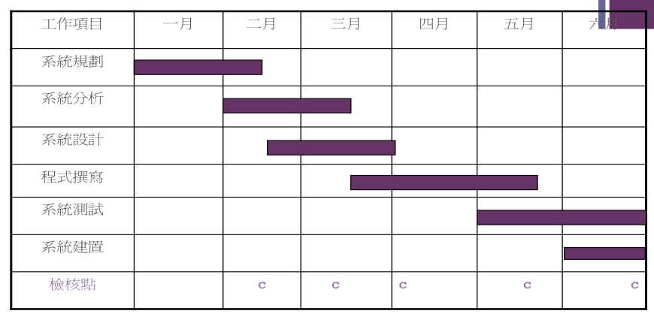
Gantt Chart
現代管理學 ch1 管理者與管理
1-<number>

Slide 10
Scientific Management School Today
Traditional management reliance solely on experience(經驗)and intuition(直覺)。
Utilizing time studies(工時研究)to boost productivity(生產力) 。
Hiring the most qualified(符合資格) workers雇用最的工人。
Designing incentive systems(激勵制度) based on output根據產量來設計。
  But dehumanizing(沒人性)?
現代管理學 ch1 管理者與管理
1-<number>

Slide 11
3. Administrative Management (行政理論學派)
Administrative Management emphasizes aspects(層面)related to managers and the entire organization
Henry Fayol(亨利．費堯)
Luther Gulick(路德．古力克 )
Max Weber(馬克思．韋伯)
Chester Barnard(柴斯特．巴納德)
Herbert Simon(賀伯特．賽門)
現代管理學 ch0管理思潮的演進
1-<number>

Slide 12

亨利．費堯 Henry Fayol
Father of administrative theory, also known as the father of modern management theory(現代管理理論)
Corporate activities are divided into two major categories: corporate functions(企業功能) and management functions(管理功能),
  Fourteen management principles(管理原則)，
    Emphasizing that identical principles(原則)need not be applied in identical situations(情境), as different contexts require different considerations.
    Divided into six parts: technical activities, commercial activities, financial activities, safety maintenance activities, and accounting activities
He pointed out that management activities differ significantly from the other five functions, encompassing five elements: planning(計畫), organizing(組織), commanding(指揮), coordinating(協調), and controlling(控制)
現代管理學 ch0管理思潮的演進
1-<number>

Slide 13
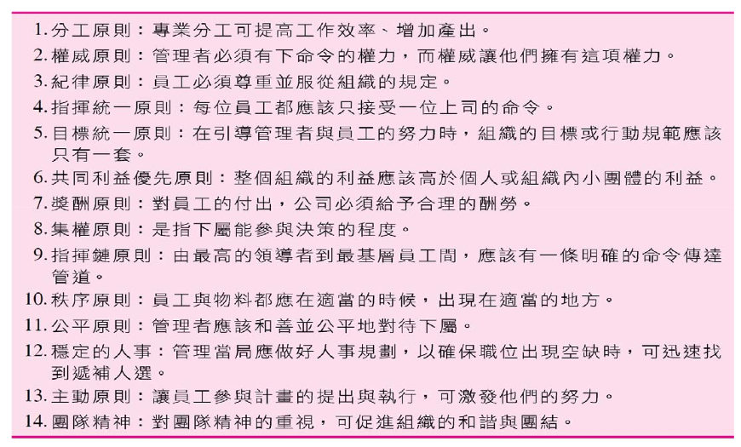
十四項管理原則
現代管理學 ch1 管理者與管理
1-<number>

Slide 14
馬克思．韋伯
“Father of Organizational Theory,” who described his ideal organizational form as a “bureaucracy”(官僚體制) or “hierarchical system.”(科層體系)
It embodies the following principles:
  Division of Labor (專業分工): Clear Hierarchy (層級明確): Detailed Regulations (詳細規範): Avoidance of Personal Relationships (不講私人關係)
Rational-Legal Model(理性法制模式)
現代管理學 ch0管理思潮的演進
1-<number>

Slide 15
官僚組織(bureaucratic organization)
serves as a blueprint for how an entire organization should function
It emphasizes rational and legal authority, constructing an organization based on professional division of labor, clear hierarchy, detailed regulations, and legitimate authority to achieve organizational goals.
Weber outlined an ideal organization focused on tasks rather than individuals. The bureaucratic ideal type, and deduced that constructing such bureaucratic organizations is the most effective structure for enterprises, governments, or military forces.
現代管理學 ch1 管理者與管理
1-<number>

Slide 16
Chester Barnard
An organization is defined as "a system of work involving two or more persons, consciously coordinating actions to organize forces." It must balance effectiveness(效能)and efficiency(效率)
Three crucial functions of managers: (1) establishing communication systems (溝通制度), (2) providing necessary personal services (必要的服務), (3) clearly organizational objectives (陳述組織的目的).
現代管理學 ch0管理思潮的演進
1-<number>

Slide 17
4. Management Science School(管理科學學派)
Management science (管理科學 ) is also known as
  management by numbers(數字管理)
  analytic management (分析式管理)
  operation research (作業研究)
  quantitative approach to management (計量管理學派)
Applications of statistical decision models (統計決策模型), optimization models(最適化模型), information models(資訊模型), and computer simulations(電腦模擬)in management. Examples:
  Linear programming techniques(線性規劃技術)
  Economic order quantity models(經濟訂購量模型)
  New product diffusion models(新產品擴散模型)
現代管理學 ch0管理思潮的演進
1-<number>

Slide 18
Linear Programming Model: Allocation of Limited Resources
Total Quality Management (TQM全面品質管理)
  Employs statistical techniques to measure key variables across organizational processes. These variables are then compared against standards (標準) to identify causes(問題) of problems and implement improvements
現代管理學 ch1 管理者與管理
1-<number>

Slide 19
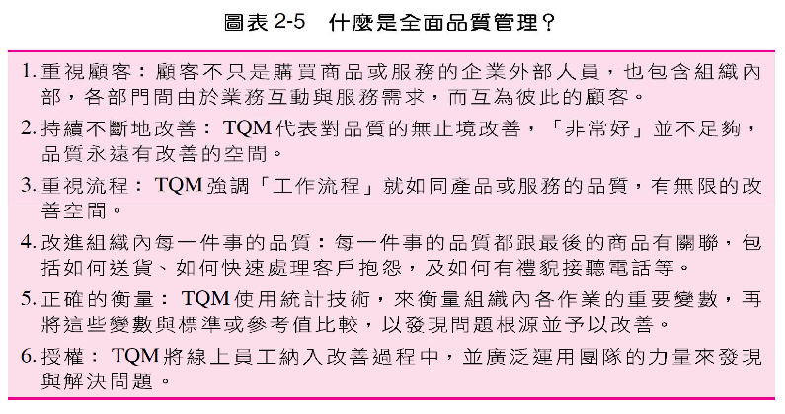
全面品質管理(TQM)
現代管理學 ch1 管理者與管理
1-<number>

Slide 20
5. Organizational Behavior School(組織行為學派)
Organizational Behavior (OB)
Studies on the activities (behavior) of people (employees) at work.
Hawthorne Effect (霍桑研究)
  Individuals perform better than usual when aware of being observed(被別人觀察), to preserve their self-esteem自尊, resulting in a temporary increase in productivity.
  This behavioral change is attributed to the hypothetical effect of environmental alteration
現代管理學 ch0管理思潮的演進
1-<number>

Slide 21
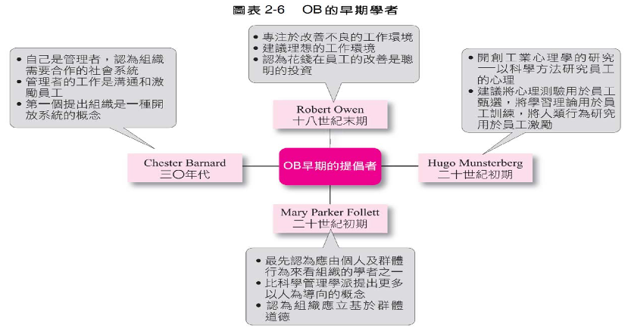
現代管理學 ch1 管理者與管理
1-<number>

Slide 22
Hugo Münsterberg(雨果‧孟斯特柏格)
Professor of Experimental Psychology(實驗心理學)at Harvard University
People are an organization's most important asset and should be managed effectively
  Psychological testing(心理測驗)→ Employee selection(選拔員工)。
  Learning theory(學習理論)→ Training process。
  Observation of human behavior(觀察人類行為)→ Employee motivation(員工激勵)
現代管理學 ch0管理思潮的演進
1-<number>

Slide 23
馬斯洛(Maslow)
馬斯洛認為人類的行為都有潛在原因，並非
偶然產生，係根源於內在需求的不滿足所產
產生的緊張，為了消除緊張，必須追求需求
的滿足，故而促使人類採取行動，產生行為
Maslow believed human behavior has underlying causes, not arising by chance.
It stems from tension caused by unmet inner needs.
To eliminate this tension, one must pursue satisfaction of needs,
thereby prompting humans to take action and produce behavior
現代管理學 ch1 管理者與管理
1-<number>

Slide 24
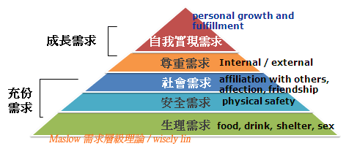
讓員工接受訓練、創意發揮，有晉升機會，以及自治。
讓員工可以得到肯定、地位、挑戰、加薪給付與參與決策制訂。
提供員工安全的工作環境、工作保障、健保及退休福利。
讓員工能夠與他人互動，參與工作團隊，並與管理者建立良好關係。
讓員工能夠有空調、飲水及底薪。
現代管理學 ch1 管理者與管理
1-<number>

Slide 25

6. Contemporary Management Theories(當代管理理論)
The Era of Marketing Management and Diversification (1946–1960)
The Era of Strategic Management (1960–1970)
The Era of Corporate Restructuring (1970–1988)
The Era of the Knowledge Economy (1988–2000)
現代管理學 ch0管理思潮的演進
1-<number>

Slide 26
The Era of Marketing Management and Diversification (1946–1960)
The “Sales-Oriented”(銷售導向) Philosophy vs. the “Marketing-Oriented”(行銷導向) Philosophy
Marketing Activities Creating Value for Customers(顧客創造價值)
現代管理學 ch1 管理者與管理
1-<number>

Slide 27
策略管理的時代(1960~1970年)
The Era of Strategic Management (1960–1970)
Effective diversification became a key management issue.
  Organizational development must closely align with the external environment.
  Senior managers determine the company's strategic positioning(策略定位) and long-term goals(長期目標), delegating execution to department heads (部門主管).
  Resources are rationally allocated to break through the status quo and counter competitors.
現代管理學 ch0管理思潮的演進
1-<number>

Slide 28
The Era of Corporate Restructuring (1970–1988)
Business Restructuring (企業再造)
  The primary goal was to reorganize work previously dispersed across departments according to operational processes most advantageous for business operations, enabling companies to respond effectively to market changes.
Down-sizing(縮減規模)
  Companies reduced their workforce
現代管理學 ch0管理思潮的演進
1-<number>

Slide 29
The Knowledge Economy Era (1988–2000)
Competitive advantage (競爭優勢) stems from knowledge
Transforming employee knowledge into collective knowledge (集體知識) in organization.
現代管理學 ch0管理思潮的演進
1-<number>

Slide 30
Review and Outlook(回顧與展望)
Management focus shifts to customer needs (顧客的需求)
Management focus shifts to the environment (環境) and competitors (競爭者)
Management focus shifts back to management efficiency(管理效率)
The rise of knowledge management(知識管理)
Emphasis on continuous innovation(不斷地創新)
Senior leaders as vision(願景) shapers
AI and Big Data Era → ChatGPT has been around for 4 years.
1-<number>

Slide 31
張忠謀的決策金字塔理論-2
張忠謀的金字塔理論最底層是靠著大量的資料（data）當基礎，整理出資訊（information）、這些資訊變成了知識（Knowledge）、也提供了決策者洞察力（insight），進而成為創新的基石，決策者就是靠著這些尖端訊息，整合、聯想。

Slide 32
上課方式
投影片
  自行到moodle Teaching Method Slides Access via Moodle
In addition to traditional management content, case introductions are included.
  Case Studies Case Discussions Case Presentations
Contact Information
  Room 5017, Management Building, Extension 4675
  Office Hours: Wed 1:00 PM – 3:00 PM
現代管理學 ch1 管理者與管理
1-<number>

Slide 33
Exam and Grade (考試與成績)
Exam Date 考試時間
  3/28, 5/2, 6/6 Exam Dates 3/28, 5/2, 6/6
Exam Method 考試方式
  Open book(s)
Grade 成績計算
  Grading 30% each, 10% class participation
現代管理學 ch1 管理者與管理
1-<number>

